Slide 1

CS 533 INTRO TO DATA SCIENCE
Michael Ekstrand

Slide 2
DATA TYPES AND OPERATIONS

Slide 3
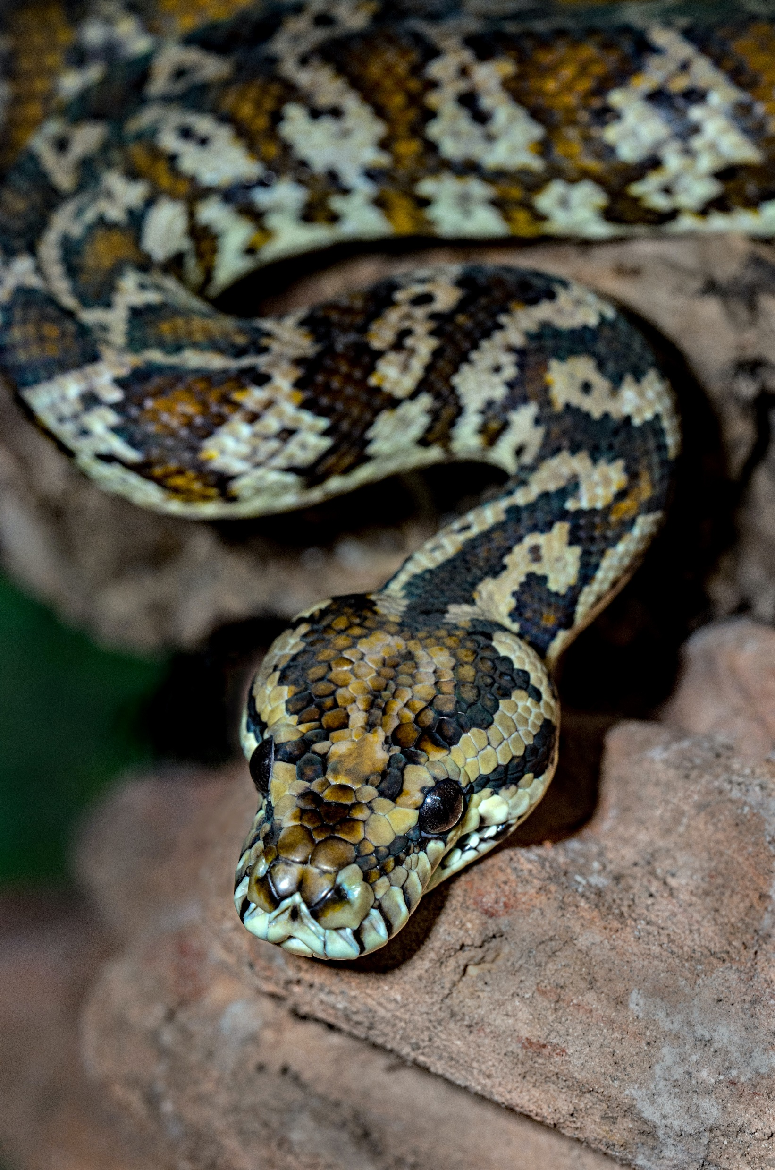
Learning Outcomes
Understand basic Python data types and operations
Store Python objects in variables
Write simple Python code to do arithmetic
Perform basic operations with lists and dictionaries
More resources linked!

Slide 4
Numbers
Python supports numbers like other programming languages
Integers: 1, 2, 47
Floating-point (decimal-ish): 3.5, 1.9, 2.4492
Can write in scientific notation: 6.02214e23
Can be negative: -3.14

Slide 5
Numeric Operations
Normal arithmetic operations behave how you expect:
+ - / *
Power: 2**5
Division is always floating-point: 5 / 2 is 2.5
Floor (integer) division: 5 // 2 is 2

